Slide 1
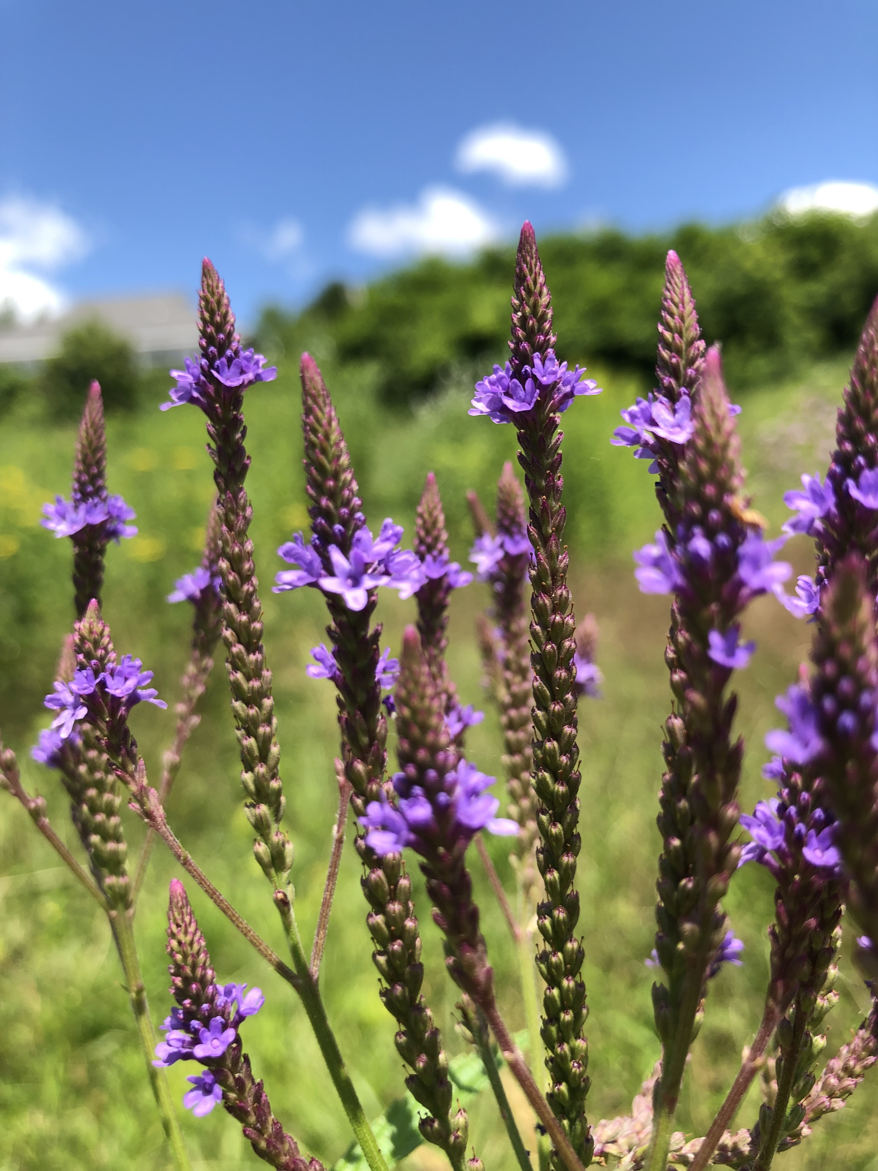
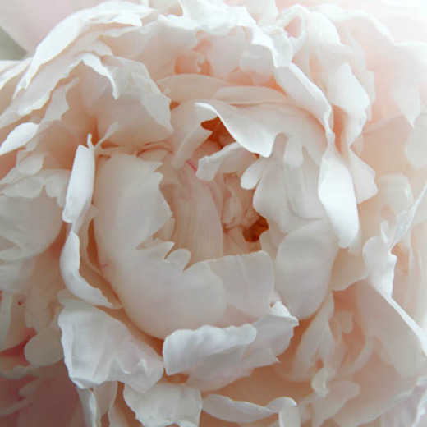
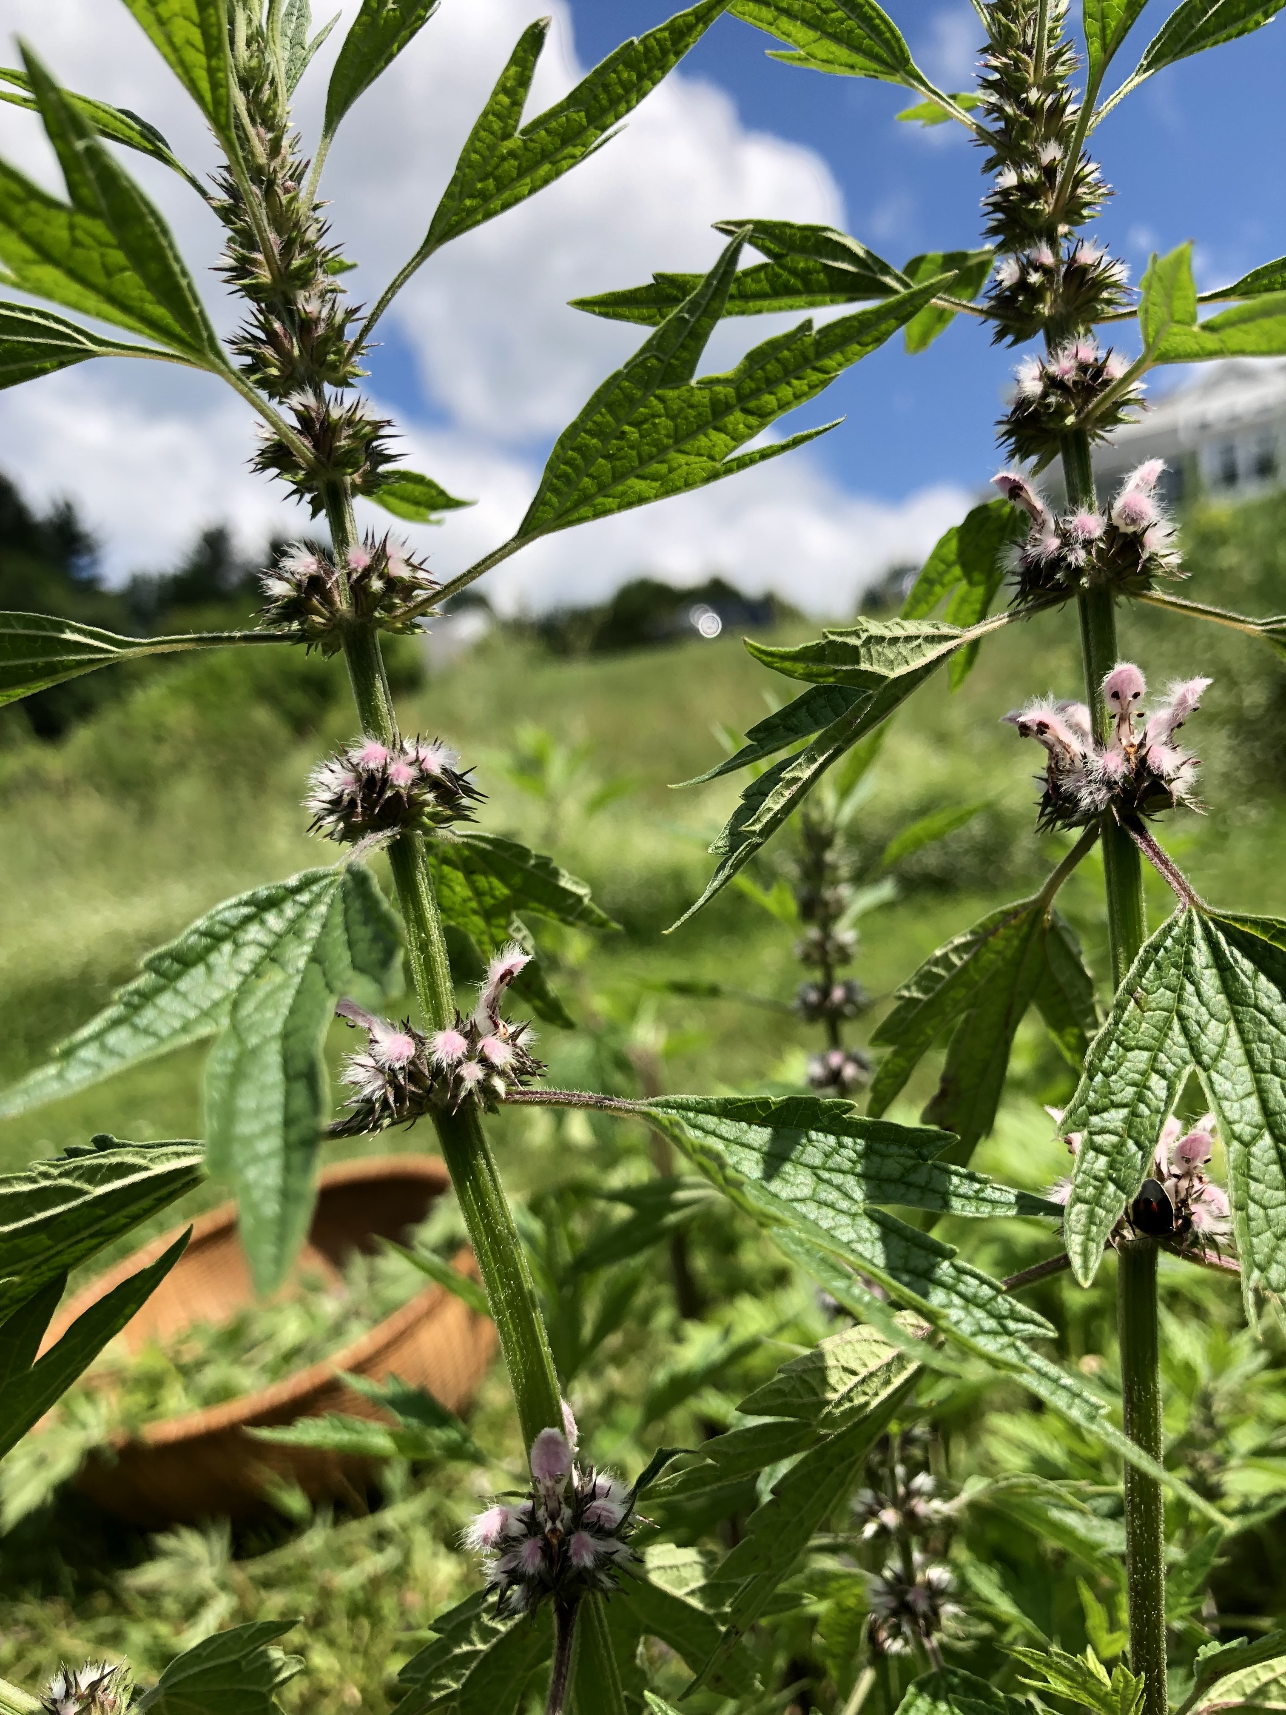
Qi & Blood Stagnation ~An Energetic Pattern with Clinical Application~
Kristin Henningsen MS, RH (AHG), RYT
AHG 2019

Slide 2
Qi and Blood: A Primer
Qi: Considered vital force responsible for all the bodies functions
Qi guides the blood
Liver is responsible for smooth flow of Qi
Blood: Nourishes and provides moisture for the tissues
Spleen makes Blood
Good Spleen function is needed for good blood production
If either Qi or Blood are deficient:
Stagnation can result
If either Qi or Blood are stagnant/blocked:
The other will eventually also become stagnant
Good Liver function is needed to prevent stagnation
Liver moves the Qi
Qi moves other fluids
Stagnant fluids/dampness can also impinge on Blood flow, lymph, etc. and vice versa

Slide 3
www.wikimediacommons.org

Slide 4
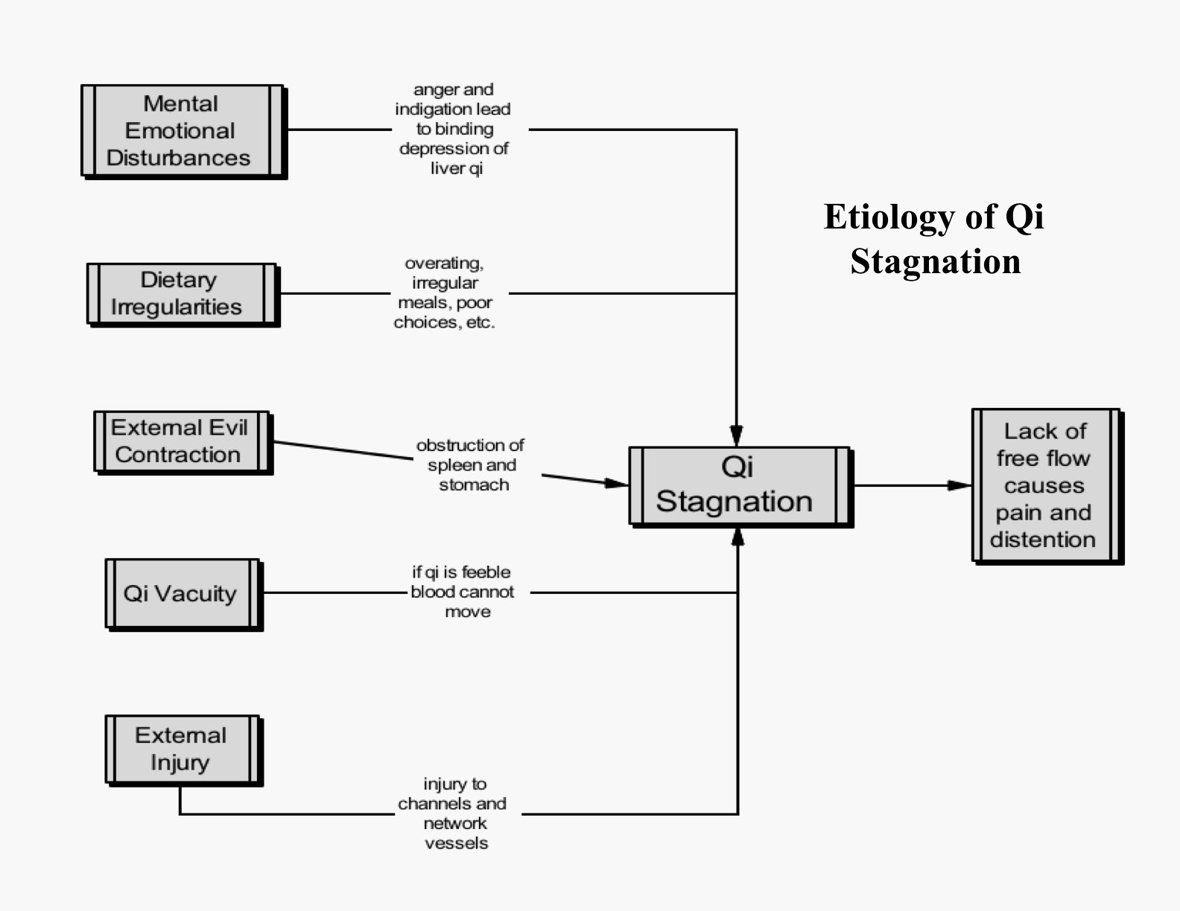
http://www.chineseherbacademy.org/flowcharts/qi_stag.gif

Slide 5
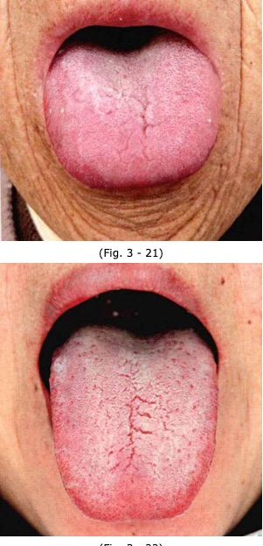
Qi Stagnation
Often swollen
Slightly red to light purple
Cracking in spleen/stomach area common
Coating can be light to medium
https://giovanni-maciocia.com/tongue-gallery/

Slide 6
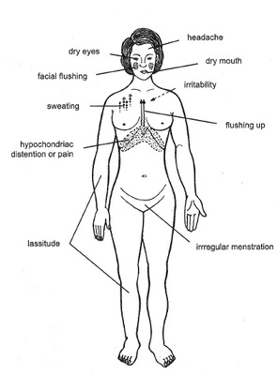
Liver Qi Stagnation Symptoms

Slide 7
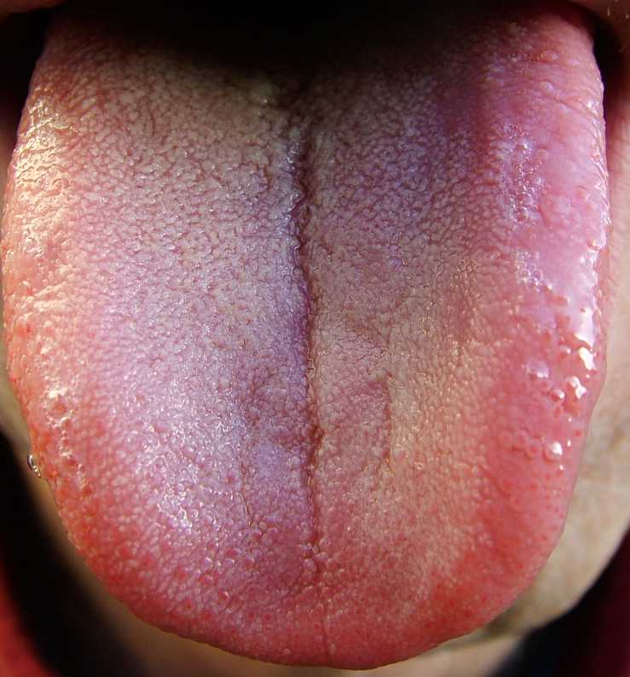
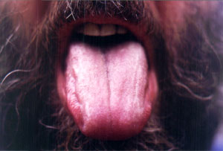
Liver Qi Stagnation
Tongue red, with more pronounced color on sides
Light coating, possibly yellow
Often dry
https://giovanni-maciocia.com/tongue-gallery

Slide 8
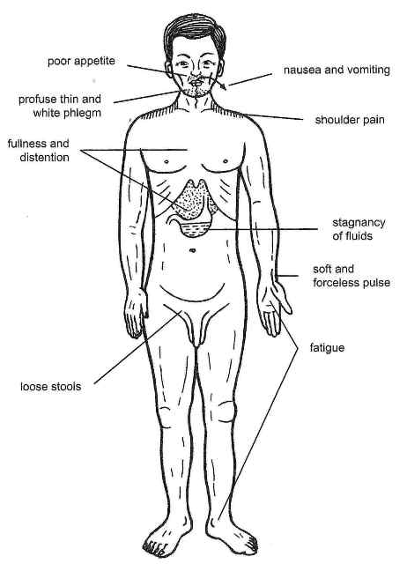
Spleen Qi Deficiency
Symptoms

Slide 9
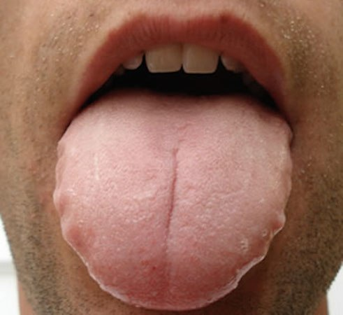
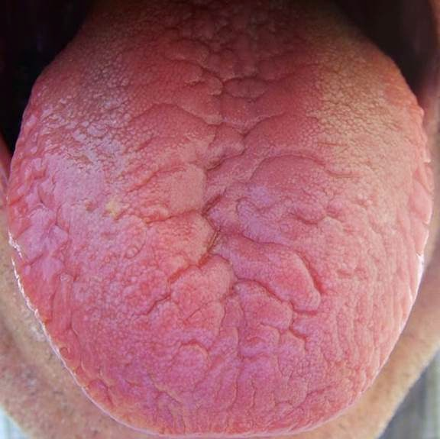
Spleen Qi Deficiency
Leading to Dampness: Scalloped edges, depression in center, pale
Leading to Yin Deficiency: Red, cracking, swollen, dry
https://giovanni-maciocia.com/tongue-gallery
Notes:
Credit to Maciocia tongue gallery

Slide 10
http://www.chineseherbacademy.org/herbs1_reader_1.html#stasis

Slide 11
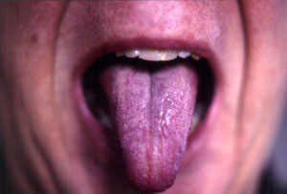
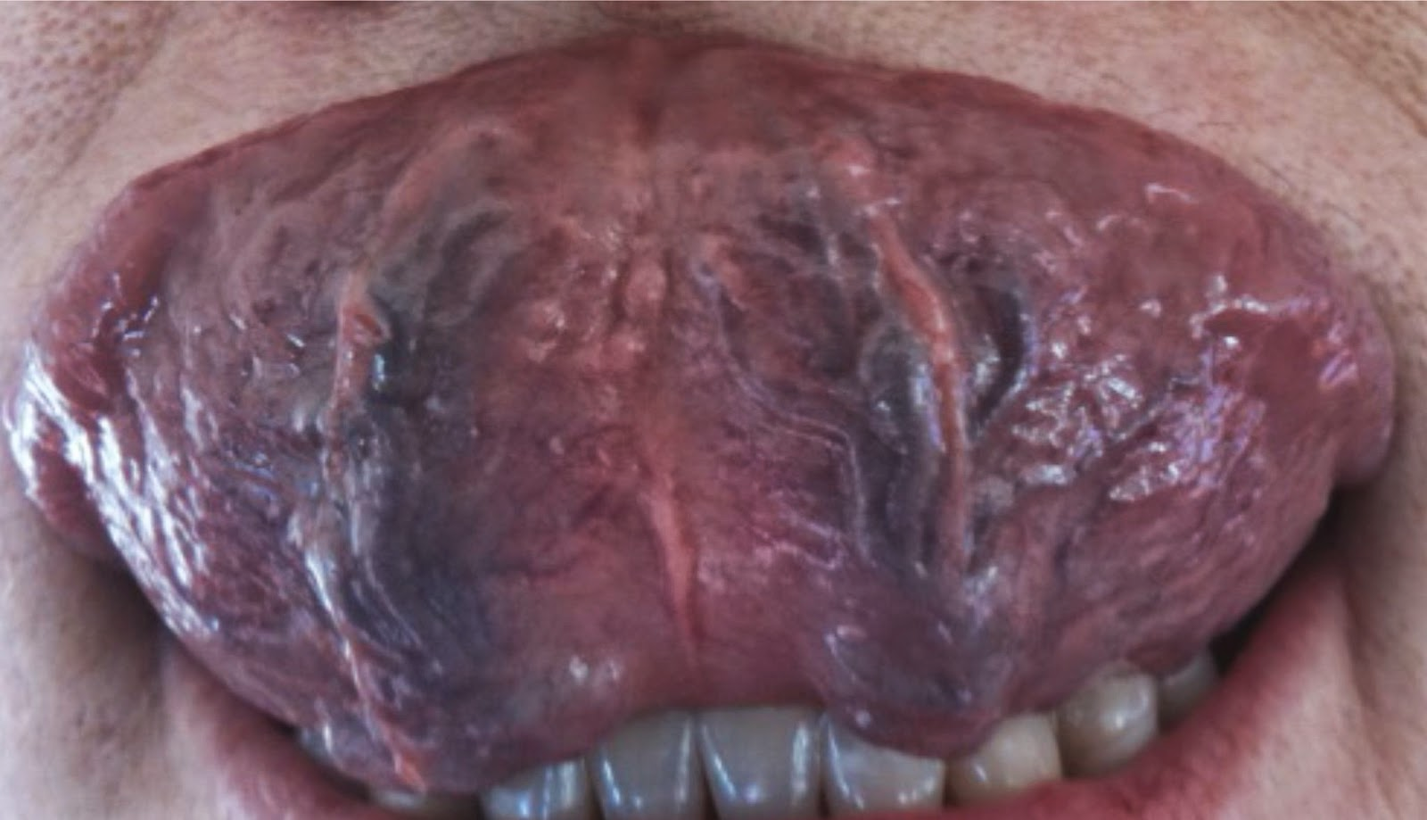
Blood Stagnation
Reddish purple, with darker purple spots
Sublingual veins distended
https://giovanni-maciocia.com/tongue-gallery

Slide 12
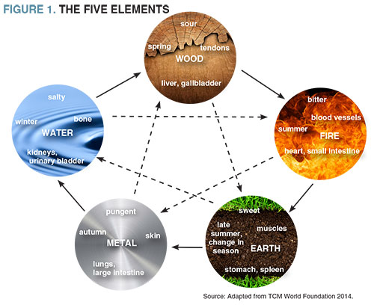
Energetics
Liver Qi Stag
Irritation/heat (Hypertension, anxiety/stress, inflammation)
Dry/Deficient (Chronic Fatigue, depression, migraines)
Spleen Qi Stag
Damp (Cysts, chronic loose stools, Candida)
Dry: Yin/Blood Deficiency (Fatigue, constipation, inflammation)
Blood Stagnation
Deficient: Qi/Blood/Yin (Pain, fatigue, varicosities)
Hot or Cold (Pain, HBP, LBP)
*Likely a combo of several

Slide 13
Goals
Build/Nourish Qi
Move Blood/Qi
Move Liver Qi stagnation
Nourish Spleen Qi Deficiency
Relax/cool Nervous System
Move/drain fluids
Support CV system
Regulate water movement
Reduce pain, if present

Slide 14
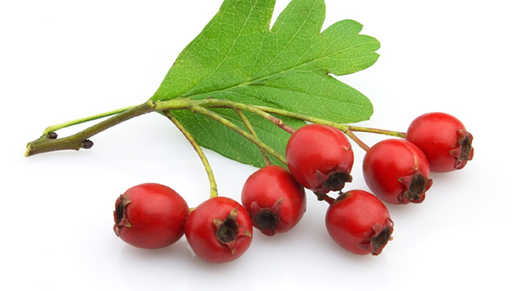
Key Actions/Herbs
Qi tonics:
Eleuthero, Astragalus, Mushrooms, Codonopsis
Circulatory stimulants:
Garlic, rosemary, cinnamon, Dan Shen, Motherwort, Gingko
Blood/yin tonics:
Dang gui, white peony, linden, hawthorn, blueberry/bilberry, goji, jujube
Hepatics:
Dandelion, blue vervain, schisandra, milk thistle, artichoke, yarrow
Spleen qi tonics (bitters, aromatics):
Angelica, cardamom, cinnamon, citrus peel, chamomile
Shen Sparklers:
Lemon Balm, Albizzia, Tulsi, Linden, Goji, Jujube

Slide 15
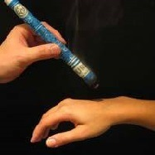
Supportive Strategies
Creativity
Movement
Massage
Acupuncture/Acupressure
Moxibustion
Diet:
Liver Qi Stagnation- decrease dairy, high fat foods, increase pungents, aromatics, brassicas, alliums, increase bitter and sour
Spleen Qi Deficiency- increase warming, drying foods, decrease raw foods
By Karan0293 - Own work, CC BY-SA 4.0, https://commons.wikimedia.org/w/index.php?curid=38457212

Slide 16
References
Maciocia, G. (2013). Foundations of Chinese Medicine. Elsevier: China.
Pitchford, P. (2002). Healing with Whole Foods. North Atlantic Books: Berkley, CA.
Tierra, L. (2003). Healing with the Herbs of Life. Crossing Press: Berkley, CA.
Tilgner, S. (2009). Herbal Medicine from the Heart of the Earth. Wise Acre Books: Pleasant Hill, OR.
Sumanran, V. & G. Tillus. (2012). Cancer, Inflammation, and Insights from Ayurveda. Evidence Based Complementary and Alternative Medicine.
Scheid, V. (2013). Depression, Constraint, and the Liver: (Dis)assembling the Treatment of Emotion Related Disorder in Chinese Medicine. Cult Med Psychiatry. 37:30-58
Wood, M. (2002). The Energetics of Physiomedicalism. Journal of the American Herbalist Guild.
Wood, M. (2016). The Earthwise Herbal Reperatory. North Atlantic Books: Berkley, CA.

